Slide 1
Recommend most suitable neighbourhood for homebuyers
Bijay Kumar Gupta
31 July 2020

Slide 2
Home buyers decide upon right neighbourhood
People move around based on their requirement of change in work location, to live in a neighbourhood which is better suited to their current and future needs or change in living preference
When facing this situation of changing location it is quite a time consuming task to identify the best location that fits the requirement
Based on the places of interest within the vicinity of home, neighbourhoods can be classified in different categories

Slide 3
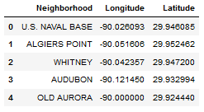
Data collection
I have decided to work on “New Orleans, Louisiana”. A list of all the neighbourhoods can be found on the Wikipedia page (link). There are 72 total neighbourhoods, we get neighbourhoods and latitude & longitude for them (as shown below)

Slide 4
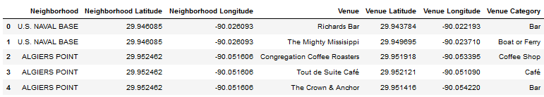
Data collection (contd.)
“Foursquare” API is used to get the data of venues around neighbourhood. We have merged venues data with neighbourhood as show below. There are 2703 venues around all neighbourhoods

Slide 5
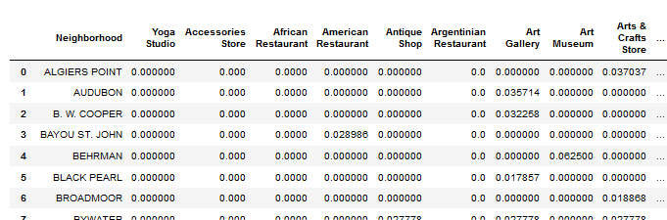
Data preparation
We have realigned data into rows of neighbourhoods and columns of venues and values as average of occurrence (as shown in below figure)

Slide 6
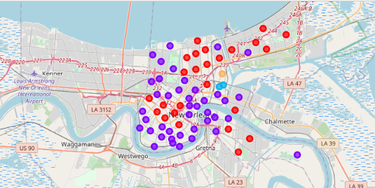
Modelling
Using k-mean clustering methods which is unsupervised method we have classified each neighbourhood into 5 clusters

Slide 7
Conclusion & Discussion
Based on modelling results we can classify each neighbourhood in one of 5 category
Home movers can use this report to pick a similar neighbourhood when deciding to move
In future we can include data on train/bus/air travel location – for frequent travellers distance of these location is a important factor.

